Slide 1



Noida Institute of Engineering and Technology, Greater Noida
Customer Relationship Management (AOE0865)
Unit: 1
Unit 1: Introduction to Customer Relationship Management
Ms. Rachna Sharma
CSE(DS) Department
B Tech 8th sem

Slide 2
Vision & Mission of Institute
Vision
To be an institute of academic excellence in digital arena with global outreach delivering socially responsible professionals to become a university and an entrepreneurial hub.
Mission
To impart quality education and hone students' skills and competencies making them future ready.
To foster an ecosystem for research, product development, innovation, incubation, and entrepreneurship.
To instill values and ethics to produce socially responsible technocrats addressing global problems.
To develop an environment for sharing and exchange of resources globally for lifelong learning.

Slide 3
Vision and Mission of the Department
Vision
To attain worldwide acclaim as an Information Technology department fostering skilled IT professionals and entrepreneurs committed to strong societal values amidst the swiftly changing digital environment.
Mission
To cultivate proficient IT professionals and entrepreneurs by providing top-tier education.
To nurture an environment encouraging collaborative research and innovation among both faculty and students, utilizing state-of-the-art IT technologies.
To impart moral principles and values, molding socially conscientious technocrats equipped to tackle global challenges.
To create a global exchange platform that provides lifetime ongoing learning opportunities.

Slide 4

Customer Relationship Management
Introduction of CRM
Emergence of CRM
Models of CRM
Importance of CRM
CRM Cycle
CRM in Modern Context
Understanding Relationships
Need for Relationships
Building Customer Relationships
Evolution of Relationships as a Marketing Tool
Customer Satisfaction, Value, and Loyalty
Relationship Management Theories

Slide 5
Course Objective
Understand the need for maintaining relations with the customers
Familiarize students with the concept of Customer Relationship marketing.
Acquaint the students with the terminology of Customer Relationship Marketing.
Introduce students to the various technologies and emerging trends in CRM

Slide 6
Parameters
P1 | P2 | P3 | P4 | P5 | P6
Subject and faculty profile with photograph* | Evaluation Scheme, Subject Syllabus and branch wise applications(Content wise)* | Course Objectives* | CO-PO CO-PSO and Mappings* | Result Analysis* (Average Subject Marks Pass Percentage) | End Sem Question Paper template*
P7 | P8 | P9 | P10 | P11 | P12
Prerequisite/ Recap* (Content Wise) | Brief subject introduction with video*(Unit wise) | Unit Content Add Use cases and applications Videos PBL/ABL etc. as per required, objectives and topic objective* | Daily Quiz,MCQs,Glossary and Weekly Assignment* | Old Exam Question Papers / Expected Questions for University Exam* | Recap of Unit*
(Red Highlighted texts should be for Only 1 Unit)

Slide 7

Noida Institute of Engineering and Technology, Greater Noida
Introduction of CRM
A system and strategy for managing a company’s interactions with current and potential customers.
Combines data analysis, marketing, sales, and service practices.

Slide 8
Noida Institute of Engineering and Technology, Greater Noida
Emergence of CRM
Historical Background:
Originated from sales automation systems in the 1980s.
Shift from transactional marketing to relationship marketing in the 1990s.
Drivers of CRM Emergence:
Increased competition.
Technological advancements.
Customer-centric business strategies.

Slide 9

Noida Institute of Engineering and Technology, Greater Noida
Models of CRM
Operational CRM: Focuses on automation of sales, marketing, and customer service processes.
2. Analytical CRM:
Analyzes customer data to improve decision-making.
3. Collaborative CRM:
Enhances communication between businesses and customers.

Slide 10
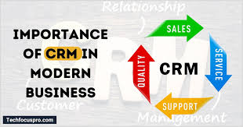
Noida Institute of Engineering and Technology, Greater Noida
Importance of CRM
1. Improves customer satisfaction and loyalty.
2. Streamlines sales and marketing efforts.
3. Provides actionable insights through data analytics.
4. Enhances communication across teams.
5. Drives business growth and profitability.

Slide 11
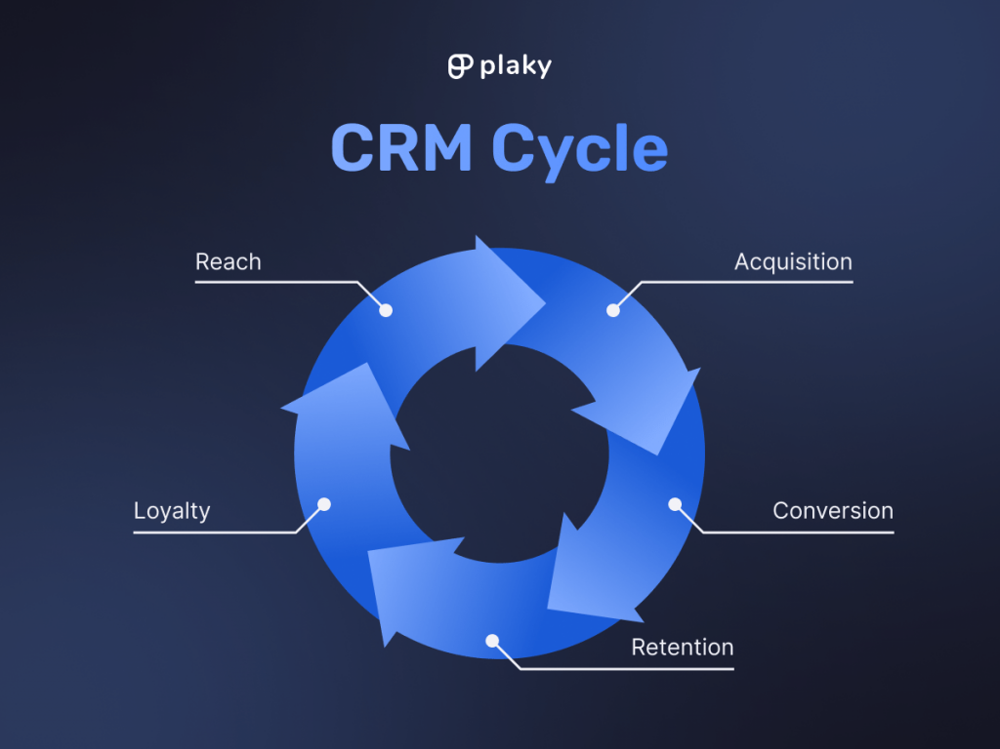
Noida Institute of Engineering and Technology, Greater Noida
CRM Cycle
Phases of CRM Cycle:
Acquisition: Attracting new customers.
Retention: Keeping existing customers satisfied.
Extension: Upselling, cross-selling, and building loyalty.
Key Activities: Data collection, segmentation, interaction, and feedback.

Slide 12
Noida Institute of Engineering and Technology, Greater Noida
CRM in Modern Context
Cloud-based CRM solutions (e.g., Salesforce, HubSpot).
Use of AI and machine learning in customer insights.
Integration with social media and omnichannel platforms.
Personalization and predictive analytics for enhanced engagement.

Slide 13
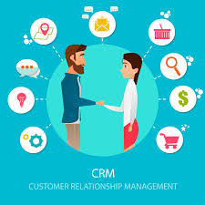
Noida Institute of Engineering and Technology, Greater Noida
Understanding Relationships
Definition of Customers and Relationships:
Customers: Individuals or organizations that buy products/services.
Relationships: Ongoing interactions between businesses and customers.

Slide 14
Noida Institute of Engineering and Technology, Greater Noida
Need for Relationships
Build trust and rapport with customers.
Create long-term business value.
Gain competitive advantage in the market.
Foster customer advocacy and referrals.

Slide 15
Noida Institute of Engineering and Technology, Greater Noida
Building Customer Relationships
Strategies:
Personalized communication and offerings.
Proactive customer service.
Consistent engagement through loyalty programs.
Tools:
CRM software, email marketing, and social media platforms.

Slide 16
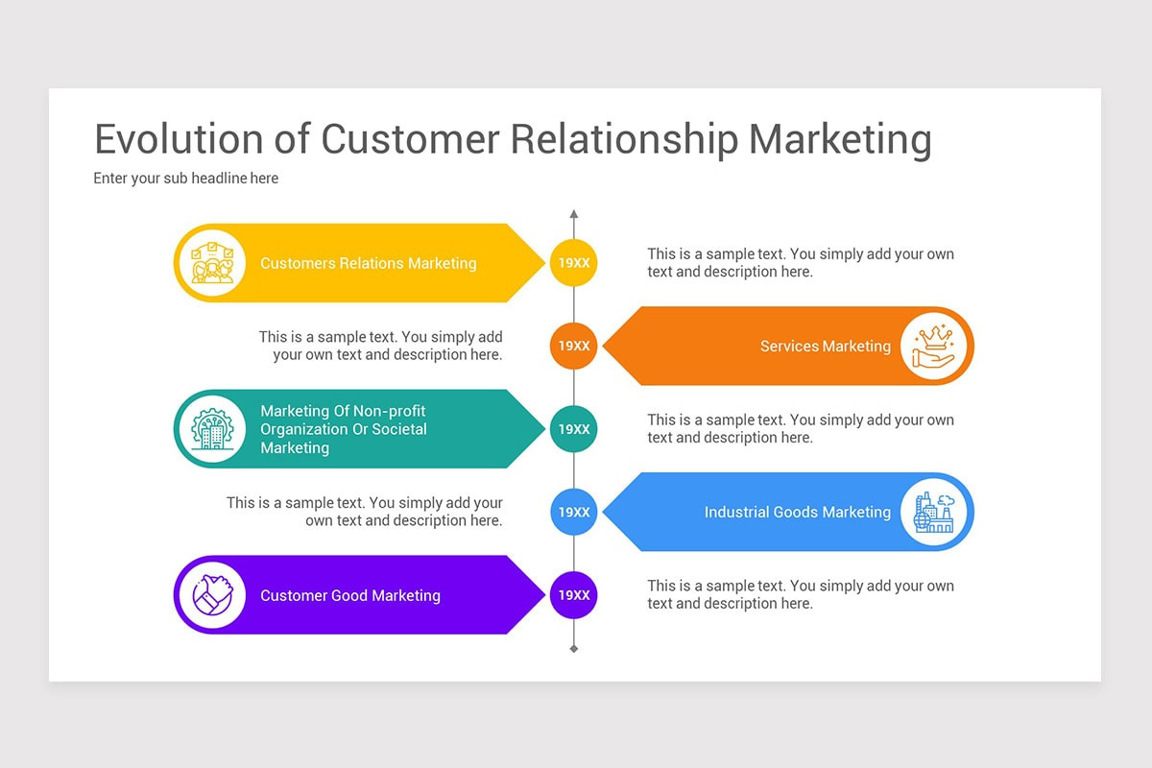
Noida Institute of Engineering and Technology, Greater Noida
Evolution of Relationships as a Marketing Tool

Slide 17
Noida Institute of Engineering and Technology, Greater Noida
Evolution of Relationships as a Marketing Tool
From Transactional to Relational:
Shift from one-time sales to ongoing relationships.
Focus on Customer Experience:
Tailoring interactions to meet customer needs and preferences.

Slide 18
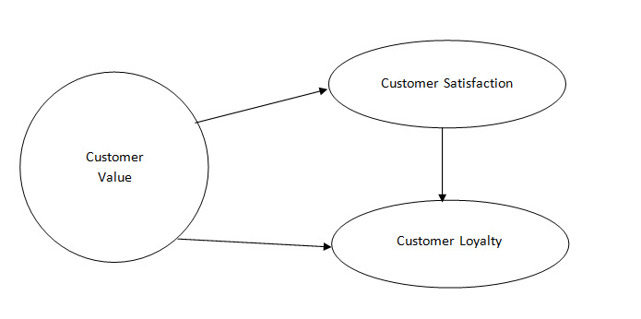
Noida Institute of Engineering and Technology, Greater Noida
Noida Institute of Engineering and Technology, Greater Noida
Customer Satisfaction, Value, and Loyalty
Customer Satisfaction:
Meeting or exceeding customer expectations.
Value:
Delivering quality products and services at fair prices.
Loyalty:
Building trust and emotional connection with customers.

Slide 19
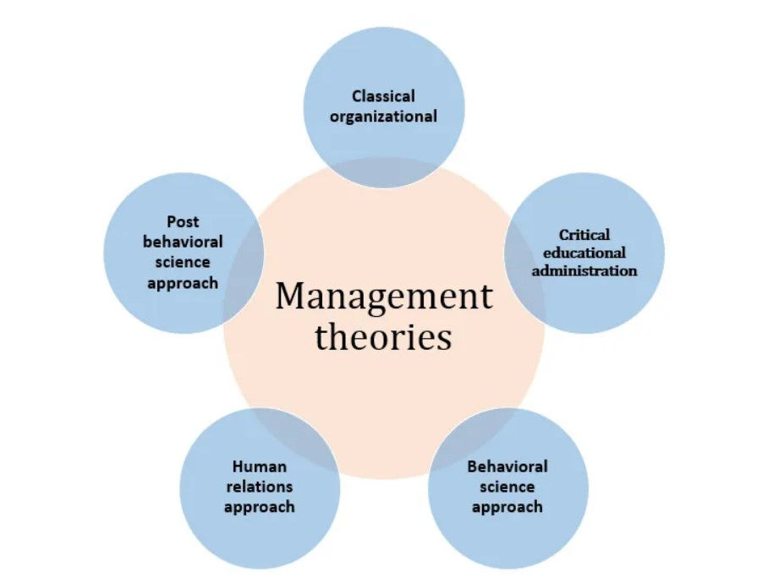
Noida Institute of Engineering and Technology, Greater Noida
Relationship Management Theories
Social Exchange Theory:
Focuses on reciprocal benefits in relationships.
Commitment-Trust Theory:
Emphasizes trust and commitment as key relationship drivers.
Customer Loyalty Ladder:
Stages from prospects to advocates.

Slide 20
Noida Institute of Engineering and Technology, Greater Noida
MCQ s
1. What does CRM stand for?
a) Customer Retention Management b) Customer Relationship Management c) Client Resource Management d) Customer Response Mechanism
2. Which of the following is NOT a type of CRM?
a) Operational CRM b) Analytical CRM c) Collaborative CRM d) Transformational CRM
3. The CRM cycle includes which of the following phases?
a) Acquisition, Retention, Extension b) Planning, Implementation, Review c) Onboarding, Analysis, Feedback d) Engagement, Forecasting, Reporting

Slide 21
Noida Institute of Engineering and Technology, Greater Noida
4. What is the main purpose of Analytical CRM?
a) Automating customer service processes b) Enhancing customer communication c) Analyzing customer data for better decision-making d) Personalizing customer interactions
5. Which CRM model focuses on improving communication across teams?
a) Operational CRM b) Analytical CRM c) Collaborative CRM d) Strategic CRM
6. The evolution of CRM began with which of the following systems?
a) Relationship marketing systems b) Cloud-based CRM platforms c) Sales automation systems d) Predictive analytics

Slide 22
Noida Institute of Engineering and Technology, Greater Noida
7. What is a key benefit of implementing CRM in an organization?
a) Reduced operational costs only b) Improved customer satisfaction and loyalty c) Faster product development d) Elimination of human resources
8. Customer satisfaction primarily involves:
a) Offering the lowest price in the market b) Meeting or exceeding customer expectations c) Following up with every customer daily d) Using only automated customer service
9. The social exchange theory in relationship management emphasizes:
a) Building customer loyalty programs b) Reciprocal benefits in relationships c) Cross-selling and upselling opportunities d) Automating all customer interactions

Slide 23
Noida Institute of Engineering and Technology, Greater Noida
10. Which of the following technologies is increasingly used in modern CRM systems?
a) Typewriters b) Cloud computing and AI c) Traditional filing systems d) Manual ledgers

Slide 24


Thank You

